Slide 1
Technical Design Authority CDO: Data Strategy and Data Governance Update
5th September 2022

Slide 2


Content
1. |  | Guiding coalition
2. |  | Data Governance Launch
3. |  | Data Strategy
4. |  | RAFT Support
2

Slide 3

Guiding Coalition

Slide 4
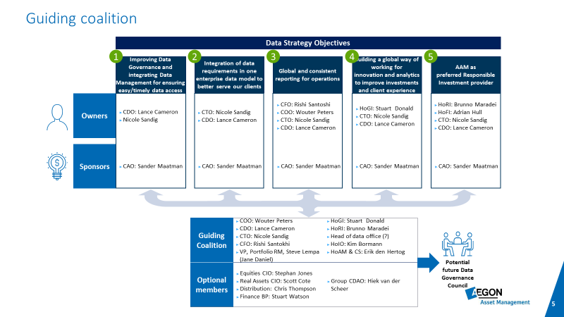
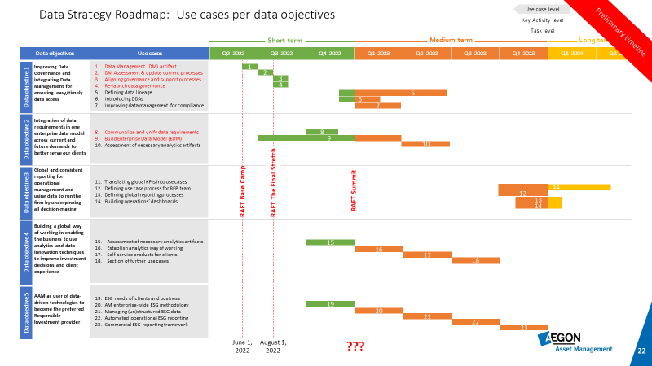
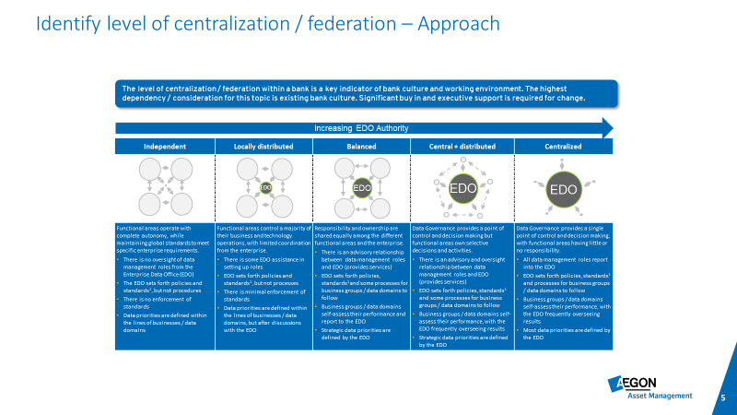
Guiding coalition approach
A
B
C
Form guiding coalition
Build 24 month roadmap
Relaunch Data Governance Program
Decide on appropriate members of guiding coalition
Discuss sponsorship/ownership responsibilities
Agree on SteerCo/Core team meeting cadence
Identify top data issues beyond data strategy
Hold workshops to understand how to execute use cases
Discuss PoC vs Prototype vs Pilot
Decompose use cases into execution plans
Summarize execution plans on a 24 month roadmap
Increase level of data literacy across the enterprise
Create and evangelize a DG charter
Convert guiding collation into DG council
Re-affirm membership/dedication of DG Community
Begin discussion/resolution of top data issues
Complications:
1
2
3
Stakeholder engagement
Competition / integration RAFT
Budget / Commitment

Slide 5
What should you expect out of the CDO role?
1
Data Strategy
Provide vision and expertise on how data strategy can be implemented to meet business objectives
Guide the creation of a data governance community (ownership/stewardship and set principles, policies and standards that ensure the effective and efficient use of information to support business initiatives.
2
Data Governance
Guide and cooperate ORM to ensure regulatory compliance and set safety protocols for monitoring and remediating risks involving data assets to business operations, decision making and products & services
3
Data Risk
CDO
Cooperate with privacy officer(s) to provide guidelines for proper usage and storage of sensitive data which includes personal and confidential data, such as financial data
4
Privacy & Ethics
5
Data Architecture
Cooperate with architecture to ensure/enforce a framework of rules and policies which manage data and its flow throughout the organization
6
Data & Analytics
Guide and cooperate analytics leadership to conduct analysis in a way that gives meaning to raw data, in order to transform it into usable knowledge.
7
Data Culture Change
Foster a data-driven orientation by prioritizing cultural change and influencing data literacy.

Slide 6
Guiding coalition focus
Translate the data strategy into a Roadmap
Time Horizon
Prioritize all use cases that support data objectives on a roadmap through a series of workshops with stakeholders. Plot all uses cases on a execution plan with a supporting budget.
1
4 months
Support project RAFT
2
Support project RAFT by providing expertise from a Data Management/Governance perspective by ensuring data management discipline is installed without disturbing RAFT timelines.
4 months
Relaunch data governance program
3
Re-launch Data Governance in the organization by transforming the guiding collation into a data governance council, embedding ownership/stewardship in the business and establishing standards/principles/policies/best practices.
4 months
4

Slide 7
Guiding coalition
Data Strategy Objectives
1
2
3a
3b
4
5
Improving Data Governance and integrating Data Management for ensuring easy/timely data access
Integration of data requirements in one enterprise data model to better serve our clients
Global and consistent reporting for operations (internal)
Global and consistent reporting for operations
(external)
Building a global way of working for innovation and analytics to improve investments and client experience​
AAM as preferred Responsible Investment provider​
Owners
CDO: Lance Cameron
CTO: Nicole Sandig
CTO: Nicole Sandig
CDO: Lance Cameron
CFO: Rishi Santoshi
COO: Wouter Peters
CTO: Nicole Sandig
CDO: Lance Cameron
HoAM & CS: Erik den Hertog
COO: Wouter Peters
CTO: Nicole Sandig
CDO: Lance Cameron
HoGI: Stuart Donald
CTO: Nicole Sandig
CDO: Lance Cameron
HoRI: Brunno Maradei
HoFI: Adrian Hull
CTO: Nicole Sandig
CDO: Lance Cameron
Sponsors
CAO: Sander Maatman
CAO: Sander Maatman
CAO: Sander Maatman
CAO: Sander Maatman
CAO: Sander Maatman
CAO: Sander Maatman
Guiding Coalition
COO: Wouter Peters​
CDO: Lance Cameron​
CTO: Nicole Sandig​
CFO: Rishi Santokhi​
VP, Portfolio RM, Steve Lempa (Jane Daniel)
HoGI: Stuart Donald​
HoRI: Brunno Maradei
​Head of data office​ (?)
HoIO: Kim Bormann
HoAM & CS: Erik den Hertog
DPO: David Hazeldine
Optional members
Equities CIO: Stephan Jones
Real Assets CIO: Lara Osterhaus
Distribution: Chris Thompson
Finance BP: Stuart Watson
Group CDAO: Hiek van der Scheer
Potential future Data Governance Council

Slide 8
What do we ask from you in the guiding coalition?
Guiding coalition
Strategic data decisions
Meeting cadence every two weeks
Prioritize and vote on strategic initiatives
Data strategy roll-out / roadmap
Data governance approach
Sponsoring data challenges

Slide 9
Guiding Coalition: Potential candidates for Data Governance Council
Guiding Coalition | Role
Wouter Peters​ | COO
Lance Cameron​ | CDO
Nicole Sandig​ | CTO
Rishi Santokhi | CFO
Steve Lempa | VP portfolio Risk Management
Stuart Donald​ | Head of Global Insights
Brunno Maradei | Head of Responsible Investments
? | Head of data office​
Kim Bormann | Head of Investment Operations
Erik den Hartog | European Head of Account Management & Client Servicing
David Hazeldine | Global DPO
Optional members
Stephan Jones | Chief Investment Officer Multi Asset & Solutions
Scott Cote | Chief Investment Officer Real Assets
Chris Thompson | Head of Global Client Group
Stuart Watson | Sr Finance business partner
Hiek van der Scheer | Group CDAO
Data Governance council chaired by CDO
Data Owner
Data Owner
Data Steward
Data Steward
Data Steward
Data Steward
Data Custodian
Data Custodian
Data Custodian
Data Custodian

Slide 10
Guiding Coalition: Prioritize our top day-to-day data challenges
Rank | Challenge Sponsor | Data Challenge Title | Description | Agile T-Shirt size | Date Added | Date Solved | Who is affected? | Business Value desc. | Regulatory compliance? (Y/N)
1 | Nicole Sandig | Data interfaces | Define all data interfaces between applications |  | 24/5/2022 | ? | Developers, Data Consumers, Data producers, DG Roles | Eliminate ambiguity and rework. | No
2 | Data Governance (CDO) /Data Architecture (Steve Harker) | Naming Standards | Ensure naming/definition standards are agreed and adhered to |  | 24/5/2022 | ? | Developers, Data Consumers, Data producers, DG Roles | Ensure certainty of what descriptions/names of concepts | No
3 | Architecture (Steve Harker) | DDAs | Data Delivery agreements missing |  | 24/5/2022 | ? | Data Consumers | Ensure predictable service levels for not only applications but also data | No
4 | Nicole Sandig | ABOR/IBOR decision making | Decide on ABOR or IBOR for reporting purposes |  | 2/6/2022 | ? | Developers, Data Consumers, Data producers, DG Roles | Provide one single reporting standard to eliminate ambiguity | Yes
5 | Data Governance | RFI/Vendor management | Data governance mandate; authority to purchase data needs to get back to governance |  | 2/6/2022 | ? | Data Governance, Vendor Management | Ensure that responsibilities are organized in the right place | No
6 | Nicole Sandig | Ten commandments for data architecture | 10 commandments that data architects must adhere to |  | 2/6/2022 | ? | Data Architecture, Data developers | Ensuring a unified way of working among data architects and developers | No
L
S
M
M
M
S

Slide 11




What progress has been made so for in (re)launching Data Governance
Data Strategy Objective 1 activated on a roadmap
Regular guiding coalition meeting
1
2
Proof of value for DG (semantic layer)
3
Develop Charter, assign ownership and stewardship
4
Formal Launch of Data Governance by mid October
5
Enterprise wide data scoping exercise to identify critical data elements
6
Milestone
Completed milestone
Not started milestone
In progress milestone
October due date

Slide 12
Timeline for relaunching Data Governance within Aegon Asset Management
Timeline for relaunching Data Governance
4th GC
Aug 8
5th GC
Aug 29
6th GC
Sep 5
7th GC
Sep 19
8th GC Oct 3
DG kick-off 17 Oct
Council structure approved
Life of a Data Element ‘What good looks like’
Time expectations of a Data Owner and Data Steward
Draft Data Governance Charter discussed
Data Governance Charter approved by the Guiding Coalition
Draft data domain model discussed
Final Data domain model approved by the Guiding Coalition
Draft Data Owners assigned
Draft Data Stewards assigned
Final Data Owners assigned and approved by the Guiding Coalition
Final Data Stewards assigned and approved by the Guiding Coalition
Data Stewards kick-off training
First Data Governance council meeting
Data Governance Lunch & learn training

Slide 13
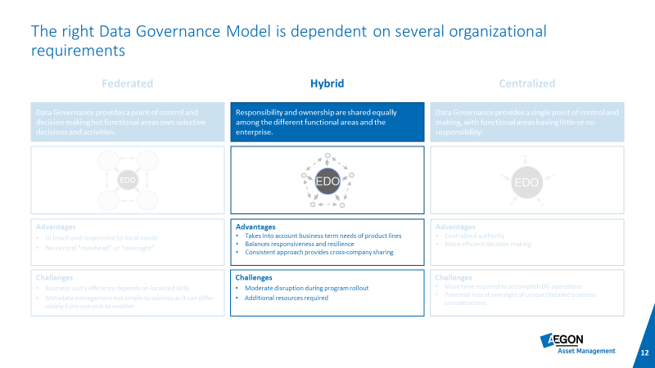
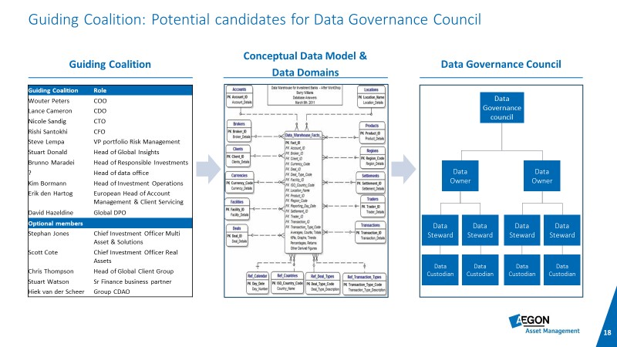
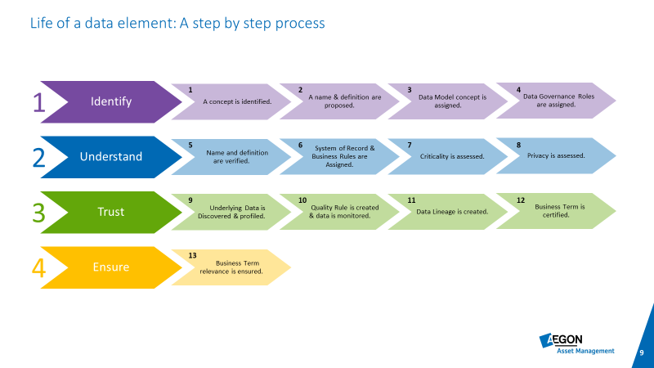
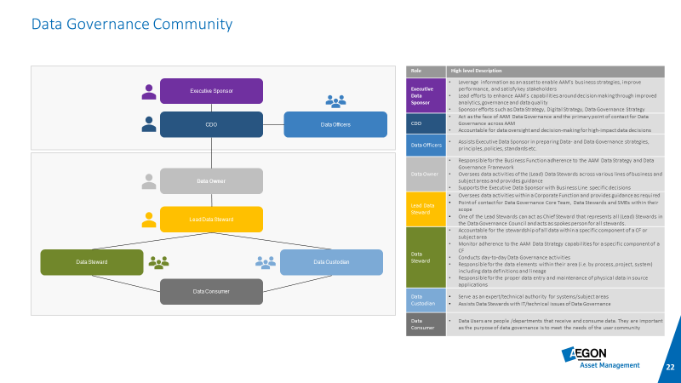
Guiding Coalition: Decisions for the Data Governance charter
Data Governance operating models
Assigning Data Owners to data domains
Life of a data element
Proposed DG council structure

Slide 14
Data Strategy Objectives and Use Cases

Slide 15
Current state
The data strategy house framework was taken as basis in building the bedrock of the new AAM data strategy
Aegon AM business strategy
Aegon AM business strategy defining organization mission, strategic goals and objectives, organizational structure and values, and KPIs will help to identify the data asset support needed and enable data teams to prioritize initiatives, make strategic choices and allocate capital
Data strategy
Aegon Group Data strategy
Current state
External factors
Aegon Group Data strategy will provide support on understanding the group’s data focus, IT investments and way of working
Current state will help to take a snapshot of the Aegon AM on organizational readiness, business processes, data management practices, data assets and technology assets
External factors include technology and regulatory developments as well as the market pressure and will support painting a holistic view of how data is and should be used to stay competitive
Requirements
Data Strategy statement
Data Strategy statement will act as a blueprint of Aegon AM’s data movement for years to come
Strategic data objective 1
Strategic data objective 2
Strategic data objective 3
Strategic data objectives will define the purpose that will help creating an overall vision and set goals and measurable steps to achieve the desired data outcomes.
Design principle 1
Design principle 2
Design principle 3
Design principle 4
Design principle 5
Design principles will act as guidance for the target state design and work as a compass for Aegon AM in operationalization of the data strategy
Organizational capabilities requirements
Organizational capabilities requirements will define the necessary people skills, roles and responsibilities, processes and methods, and performance and metrics to execute the new strategy
Data Foundation requirements
Data foundation requirements will describe the technical methods and processes that will drive the actions and decisions of the data teams

Slide 16
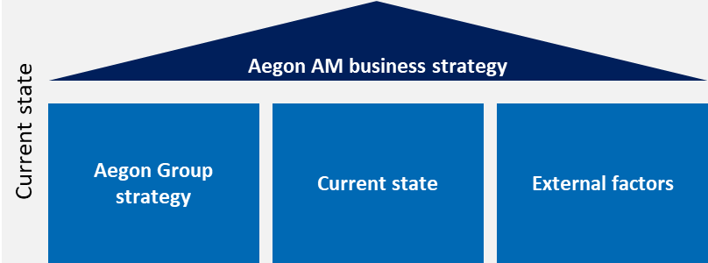








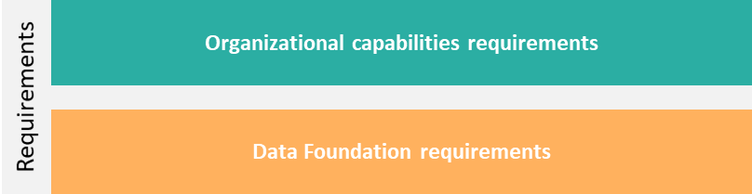
AAM’s Data Strategy
Data strategy
Data Strategy statement
AAM needs a significant investment to catch up to its competitors’ data capabilities in order to realize its business strategy of helping colleagues and clients live their best lives by becoming their trusted partner. The shared ambition among AAM departments is to get in control and understand what is currently happening in each of the business data domains to move from gut-feel management to data driven decision-making. The first step is to move from the current data silos to a data enterprise incl. a single source of truth for operational and investment data to gain control (trust & access to the relevant data) to free up the capacity to dream about applied analytics in business processes. This will make AAM an attractive employer for knowledge workers scarce in the market. When the foundational work is done, the data strategy should be evaluated and updated to keep on growing and accelerating the use of data & analytics.
#1: Improving Data Governance and integrating Data Management for ensuring easy/timely data access
#2: Integration of data requirements in one enterprise data model to better serve our clients
#3: Global and consistent reporting for operations
#4: Building a global way of working for innovation and analytics to improve investments and client experience
#5 AAM as preferred Responsible Investment provider
Strategic data
objectives
Commitment to data-driven operations
Data enterprise with one global, integrated data model
Global data management framework
Data ownership as a business responsibility
Simplified and standardized activities by automation
Facilitating and enabling business driven analytics
Holistic approach to utilizing trusted ESG data & analytics
Data design principles
Use cases

Slide 17
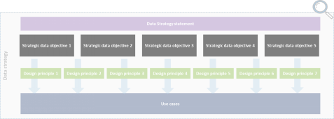








Strategic Data Objective 4: Building a global way of working in enabling the business to use analytics and data innovation techniques to improve investment decisions and client experience
Strategic data objective 4
Building a global way of working in enabling the business to use analytics and data innovation techniques to improve investment decisions and client experience
Owner (s)
Global research and insight strategy
Owner (s)
Description
Organizational Requirements
Head of Global Insights team
Executive sponsor CAO
Enablers: CTO & CDO
Facilitate an aspirational environment to further encourage using data for forward-looking analyses, realizing our commercial strategy of identifying prospective clients and opportunities to strategically position Aegon AM in new markets, eliminate manual work and measure success
Understanding our clients needs, goals and their financial landscape
Establish an analytics way of working including the relevant governance and (technology) enablers
Enable automated data feed for investment performance measurement to ensure consistent and correct advice and insights to clients
Consolidation of the pockets of information in client reporting via BI dashboards to keep up with the industry standards
Confirm executive sponsorship
Common language across regions for products and client types
Formalize a global analytics way of working to accelerate the way from ideas to analytics
Integrate analytics way of working in organizational and data governance and assign model/product ownership rules
Have enough resources in the Global Insights and other analytics teams
Provide sufficient training to relevant resources to increase Analytics literacy and awareness level
Have communication and awareness sessions about analytics possibilities
Set up stage that IT does not need to be involved for client reporting; reduce manual labor, data minded/savvy employees
Partnering with business
1
Commercial strategy & analytics to identify opportunities
1
2
3
2
Eliminate manual work
Required
Budget*
3
Measuring success
~ € 285.000 (excl. use case ideas of next two pages)
Data Foundation Requirements
O
Other
Re-platforming, automated data ingestion and integration/processing
Have the supporting IT and (data) architecture for analytics purposes and self-service BI
Include security check fields in combining internal and external data
Ongoing in-flight use cases
Foundational use cases
Timing & Dependencies
Estimated effort & resources**
Distribution screen to identify future opportunities and anticipate replacement opportunities
Automate production and distribution of actionable intelligence through Salesforce for the sales team, consultant relations, and client service teams
Assess which artifacts are necessary to build out usage of data & analytics throughout the organization (architectural capabilities such as tools, etc.)
Establish an analytics way of working including the relevant governance and enablers
Build self-service information products for clients
Select and further specify analytics use cases per department
Execute use cases 15 and 16 in given sequential order (not in parallel)
Project RAFT
#1661 - [Analytics] Global Client Group Analytics Retirement program
#96175 - [NL Retirement] Create a data driven infrastructure to support increasing client needs for customized information
Use of RPA
#46874 - Global insights framework
Concluding IG/HY research split
Enhancing RI research methods
Implementing Aladdin Research
#2180 - Impact Venture Credit investment strategy (?)
Business involvement necessary for analytics use cases to become a success
36 weeks of BI/Data analytics & science work
7 workshops requiring business teams’ involvement
1
1
2
3
1
2
3
2
2
* The required budget calculated does not take into account (where applicable) IT and licensing costs.
** The estimated effort is based on an educated guess and does not fully take into account actual timelines; more clarity will come when the roadmap is developed.

Slide 18
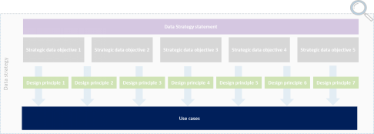
Use Cases for Data Objective 1 (3/4)
Strategic data objective 1
Improving Data Governance and integrating Data Management into our business for ensuring regulatory compliance and easy/timely access to data
Aligning governance and support processes
Align governance and supporting processes with security, privacy, compliance, legal and risk framework
Re-launch data governance
Re-launch data governance throughout the global organization based on revisited documents (focus on partnering with business); determine together with data owners the order and timeline of implementing renewed data management capabilities on data domains by taking into account the business availability
3
4
Defensive
Impact
Defensive
Impact
All Areas and departments are impacted
Minimizing data risks and possible fines by aligning regulatory data requirements from different angles
Large improvements in compliance, security and privacy
All Areas and departments are impacted
Large improvement in data ownership
Large improvement in trust to data
Effort level*
Effort level*
Build collaboration between supporting/ controlling data functions with team leads
Embed defined data management artifacts into the other processes
Organize ongoing alignment between functions
Alignment between team leads needs limited resources
1 DM specialist, 1 security specialist, 1 privacy specialist, 1 legal compliance specialist all working 20 hours/week
A global data governance program including the milestones, deliverables and the project management team is required based on use case nr. 1 and 2
3 Data office specialist 40 hours/week, 10 data stewards 5 hours/week, 4-5 data owners 5 hours/weeks all working for 6 weeks
Use case heatmap
Use case heatmap
H
H
M
M
Impact
Impact
L
L
L
M
H
L
M
H
Effort level
Effort level
Type of impact:
Revenue growth
Improved efficiency
Risk reduction/regulatory compliance
Foundation / Priority 0
* The estimated effort is based on an educated guess and does not fully take into account actual timelines; more clarity will come when the roadmap is developed.

Slide 19
Timeline for approval of Roadmap objectives within Aegon Asset Management
Timeline for launching Roadmap Objectives
4th GC
Aug 8
5th GC
Aug 29
6th GC
Sep 5
7th GC
Sep 19
8th GC Oct 3
Kick-off Obj 1 Oct 17
Objective 1 brought to the Guiding Coalition for approval
Objective 2 brought to the Guiding Coalition for approval
Objective 4 brought to Guiding Coalition for approval
Objective 3A brought to Guiding Coalition for approval
Objective 3B brought to Guiding Coalition for approval
Objective 5 brought to Guiding Coalition for approval
All objective roadmaps signed off by the Guiding Coalition
Roadmap objective 1 activated

Slide 20
STRATEGIC DATA OBJECTIVE #1: Improving Data Governance and integrating Data Management into our business for ensuring regulatory compliance and easy/timely access to data
USE CASE OWNER: Lance Cameron
Short term
Medium term
Use Cases
Key Activities
Q2-2022
Q3-2022
Q4-2022
Q1-2023
Q2-2023
Q3-2023
Q4-2023
Apr
May
Jun
Jul
Aug
Sep
Oct
Nov
Dec
Jan
Feb
Mar
Apr
May
Jun
Jul
Aug
Sep
Oct
Nov
Dec
1.
Long term
1 | Assess current documentation
2 | Review existing data model(s)
3 | Assess current Data Management tooling
1 | Update or create DG Charter
2 | Update or create DM Policies and Standards
3 | Update or create Data Domain Model
4 | Collect al DM documentation in a central location
1 | Assess current documentation
2 | Embed DM Doc elements in department
3 | Organize ongoing alignment in data government council
1 | Initiate Guiding Coalition
2 | Assign DG roles
3 | DG councils/ forums determined
4 | DG training
5 | Communication plan
6 | Kick-off Data Governance processes
1
Use Case 1
Data Management (DM) artifacts
2
3
1
2
Use Case 2
Update current processes
3
4
1
Use Case 3
Aligning governance and support processes
2
3
2024
2023
1
2
Use Case 4
Re-launch Data Governance
3
4
2024
2023
2024
5
6
2024
Note: indicates an ongoing program
2024

Slide 21
STRATEGIC DATA OBJECTIVE #1: Improving Data Governance and integrating Data Management into our business for ensuring regulatory compliance and easy/timely access to data
USE CASE OWNER: Lance Cameron
Short term
Medium term
Use Cases
Key Activities
Q2-2022
Q3-2022
Q4-2022
Q1-2023
Q2-2023
Q3-2023
Q4-2023
Apr
May
Jun
Jul
Aug
Sep
Oct
Nov
Dec
Jan
Feb
Mar
Apr
May
Jun
Jul
Aug
Sep
Oct
Nov
Dec
1.
Long term
1 | Determine and implement necessary tooling
2 | Align priorities between DG Office and Data Owners/Stewards
3 | Perform Data Lineage documentation
1 | Define scope of DDA’s
2 | Standard DDA template
3 | Training
4 | Implement DDA’s
1 | Review applicable regulations
2 | Assess Data Management policies
3 | Adjust DM/DG processes
1 | Assess existing Data Quality program
2 | Design and kick off new Data Quality program
3 | Determine necessary tooling
1
2
Use Case 5
Defining Data Lineage
3
2
2024
3
1
2
Use Case 6
Introducing DDA’s
3
2024
2024
4
1
Use Case 7
Improving Data Management for compliance
2
3
Implement enterprise wide Data Quality program
1
Use Case 8
2024
2
3
Note: indicates an ongoing program
2024

Slide 22

Use case #4: Re-launch Data Governance throughout the global organization based on revisited documents (focus on partnering with business); determine together with data owners the order and timeline of implementing renewed Data Management capabilities on data domains by taking into account the business availability
USE CASE OWNER: Lance Cameron
Additional Budget Items
Activity Owners
Potential benefits of doing this
Effort and impact estimation
Success Factors
External Collibra Specialist
Unified DG approach across Business Units
Ownership in place to accommodate improved DM
EY DM Specialist
H
Capacity
Aegon Data Officer
M
Capability
Impact
Potential risks of not doing this
Aegon Data Owner/Steward
Unavailable or insufficient data
Insufficient Data Capabilities to meet market and regulatory standards
L
Mandate
Collibra Specialist
L
M
H
Budget
Effort level
Key Activities
Effort Level
Planning
May
Jun
Jul
Aug
Sep
Oct
Nov
Dec
Jan
Feb
Mar
Apr
May
Jun
#1 Initiate Guiding Coalition
S
S
23
#2 Assign DG roles
S
M
M
#3 DG councils/forums determined
S
S
S
#4 DG training
XL
XL
XL
XL
2024
#5 Communication plan
S
S
2024
#6 Kick off Data Governance processes
XL
XL
XL
XL
2024

Slide 23
Use case #4: Re-launch Data Governance throughout the global organization based on revisited documents (focus on partnering with business); determine together with data owners the order and timeline of implementing renewed Data Management capabilities on data domains by taking into account the business availability
USE CASE OWNER: Lance Cameron
Key Activity #1
Key Activity #2
Key Activity #3
Initiate Guiding Coalition
Assign DG roles
DG councils/forums determined
Suggested Tasks
Suggested Tasks
Suggested Tasks
1
Create training syllabus for Data Owners and Data Stewards
1
Assign Data owners
1
Determine membership of DG Council
2
Form Guiding Coalition
2
Data owners assign data stewards
2
Determine DG Council meeting cadence
3
Collect top Data Challenges
3
Prepare and host workshop for data owners and data stewards given by DG office
3
Hold Data Governance Kick-off Meeting
4
Guiding Coalition kick-off meeting
4
Determine timing for launching data stewards forum
5
Hold data stewards forum kick-off
6
Decide on rotation timing for meeting chair

Slide 24
Use case #4: Re-launch Data Governance throughout the global organization based on revisited documents (focus on partnering with business); determine together with data owners the order and timeline of implementing renewed Data Management capabilities on data domains by taking into account the business availability
USE CASE OWNER: Lance Cameron
Key Activity #4
Key Activity #5
Key Activity #6
DG training
Communication plan
Kick off Data Governance processes
Suggested Tasks
Suggested Tasks
Suggested Tasks
1
Assess current ability level and decide subject matter for data owner/data steward training
1
Develop communication plan for purpose of Data Governance
1
Roll out Data Governance playbook
2
Determine need for Collibra training for Data Owners/Stewards
2
Execute communication plan
2
begin Data Governance BAU processes
3
Determine need for technical Collibra training for Data Officers
3
Periodically review for timing and content
3
Perform CDE Scoping exercise
4
Create necessary DG training material
5
Hold DG training sessions

Slide 25
Project Raft Support

Slide 26
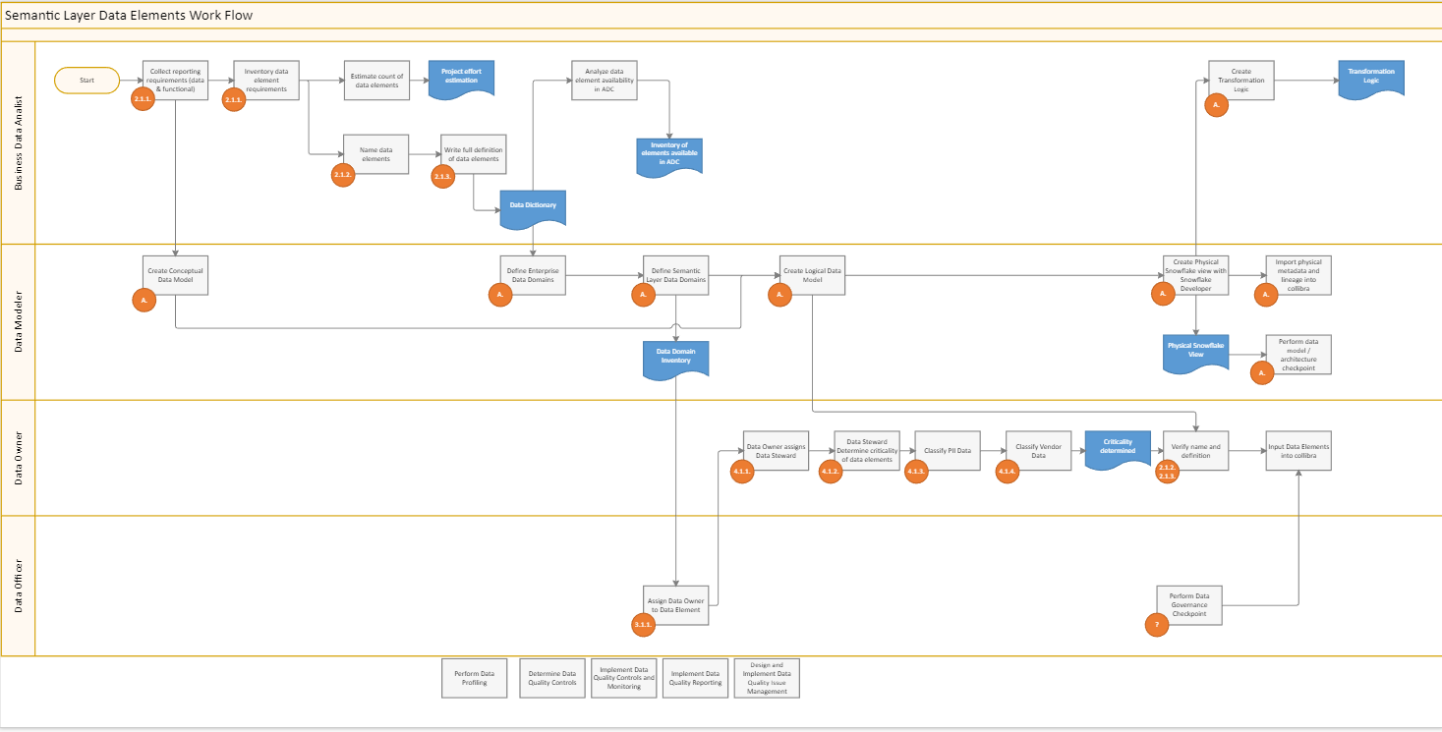
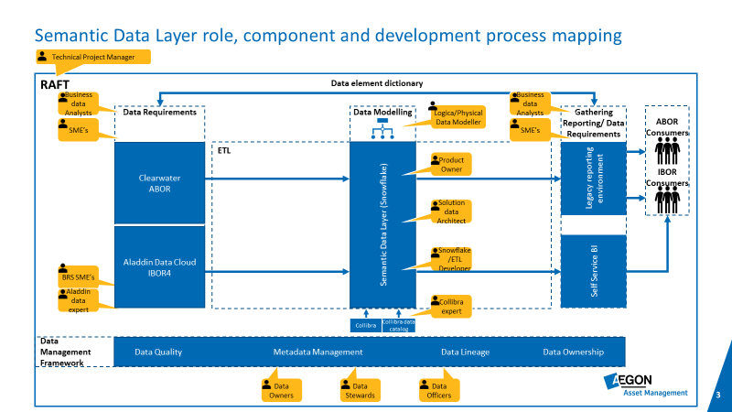
Support on project RAFT
Semantic Layer Data Governance work flow
Semantic Layer roles

